Slide 1


Slide 2
Bale Bed Hydraulic System Comparisons
Pumps & power sources
Valve types & functions
Bale bed cylinder force
Bale bed lift capacity (calculated & advertised)

Slide 3
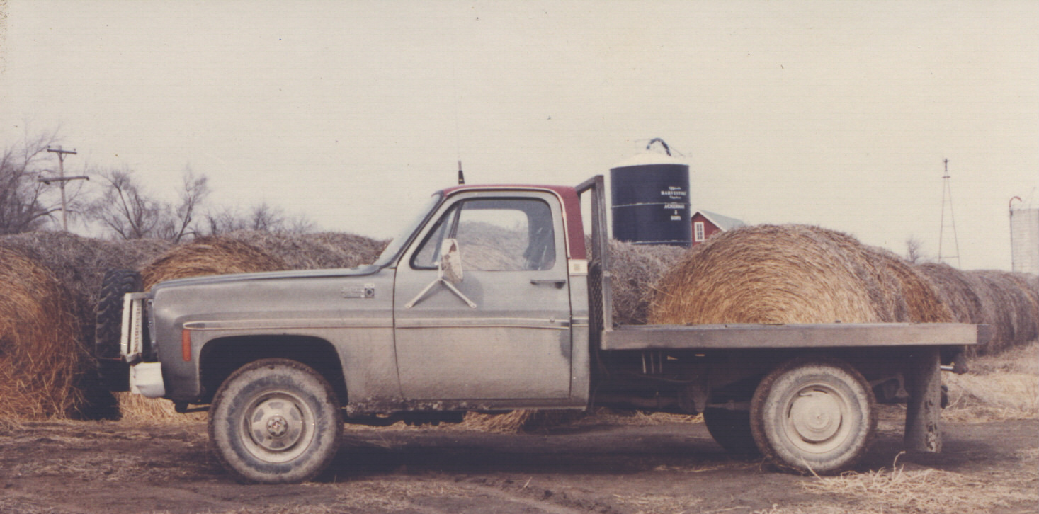
The Original Bed Hydraulic Power
In 1979, truck PTO hydraulic power seemed the only logical choice for the original unit.

Slide 4
1979-1981 Proving Ground: PTO-Driven Pump
Quickly discovered that hay bale loading, feeding & unrolling was a totally different operation than dumping & lowering a grain box once every few hours.
Was always stopping, shifting transmission to neutral, re-engaging clutch to get hydraulic power
Decided to research 12-volt hydraulics

Slide 5
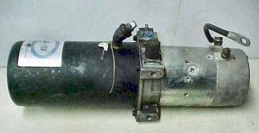
1979-1981 Research Results: 12-volt Hydraulic Systems
They were commonly used on delivery truck lift-gates & 5th wheel grain trailers
We questioned owners of 12-volt hay handlers & found that many were fed up with the problems.
In 1980, a significant number of those cattlemen intended to switch to clutch pump systems as soon as possible

Slide 6
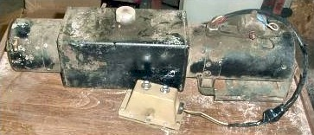
1979-1981 Research Results: 12-volt Hydraulic Systems
The common problems were:
Corrosion
Wiring fires
Dead batteries with no warranty
Another key reason mentioned to avoid 12-volt hydraulics was the frustratingly slow speed, especially in cold weather when the majority of feeding occurs

Slide 7
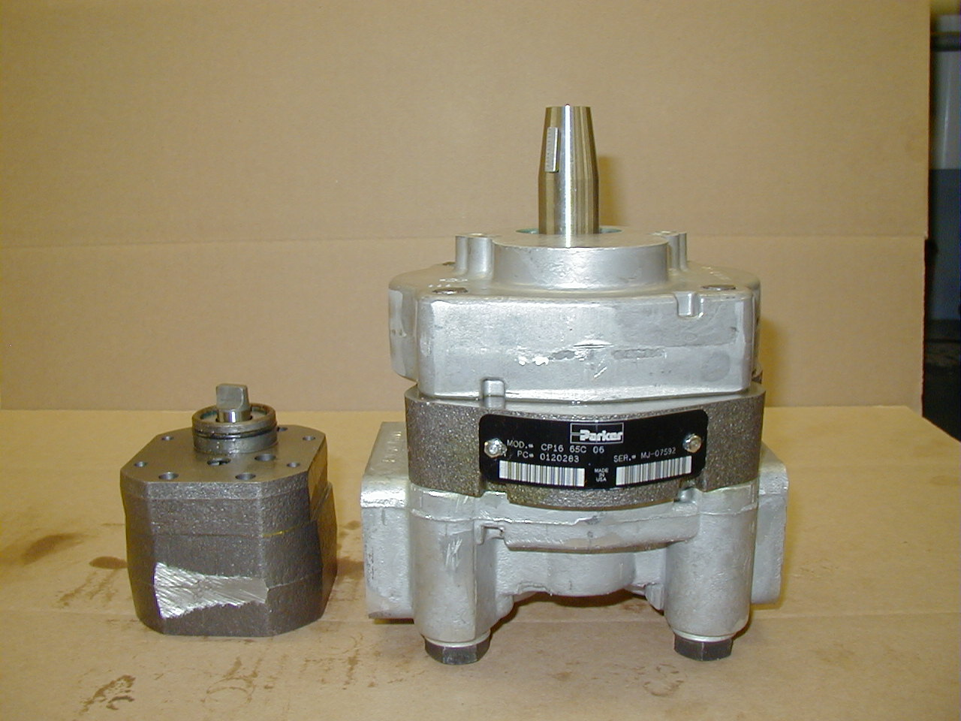
Comparison:
12-Volt vs. Clutch Pump
Final pump selection came as a result of practical comparison of features and capabilities
Gear Pump from typical 12-volt hydraulic system
Gear Pump used in Hydra Bed

Slide 8
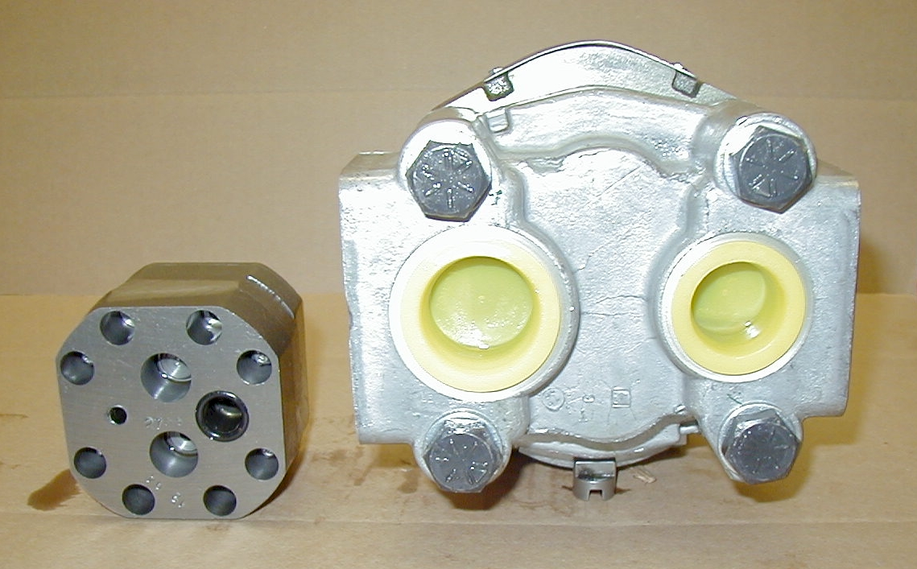
Hydraulic Pump Inlet Port Diameter
Typical 12-Volt pump inlet port diameter is 0.500”
Clutch pump inlet port is 1.000”
1.000”
.500”
Our choice: Clutch Pump

Slide 9
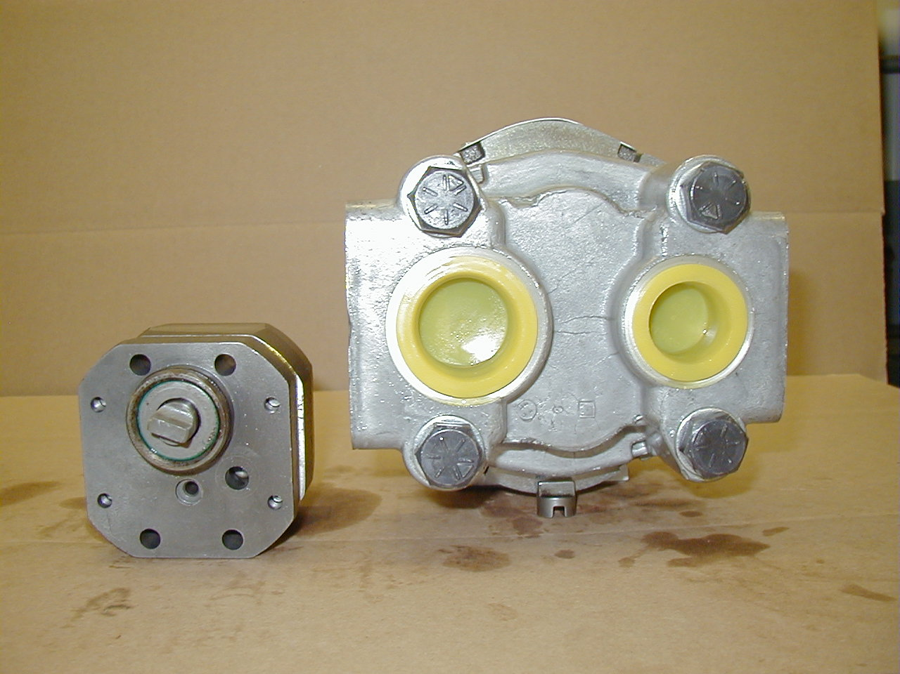
Hydraulic Pump Pressure Port Diameter
Typical 12-Volt pump pressure port diameter is 0.300”
Clutch pump pressure port is .750”
.750”
.300”
Our choice: Clutch Pump

Slide 10
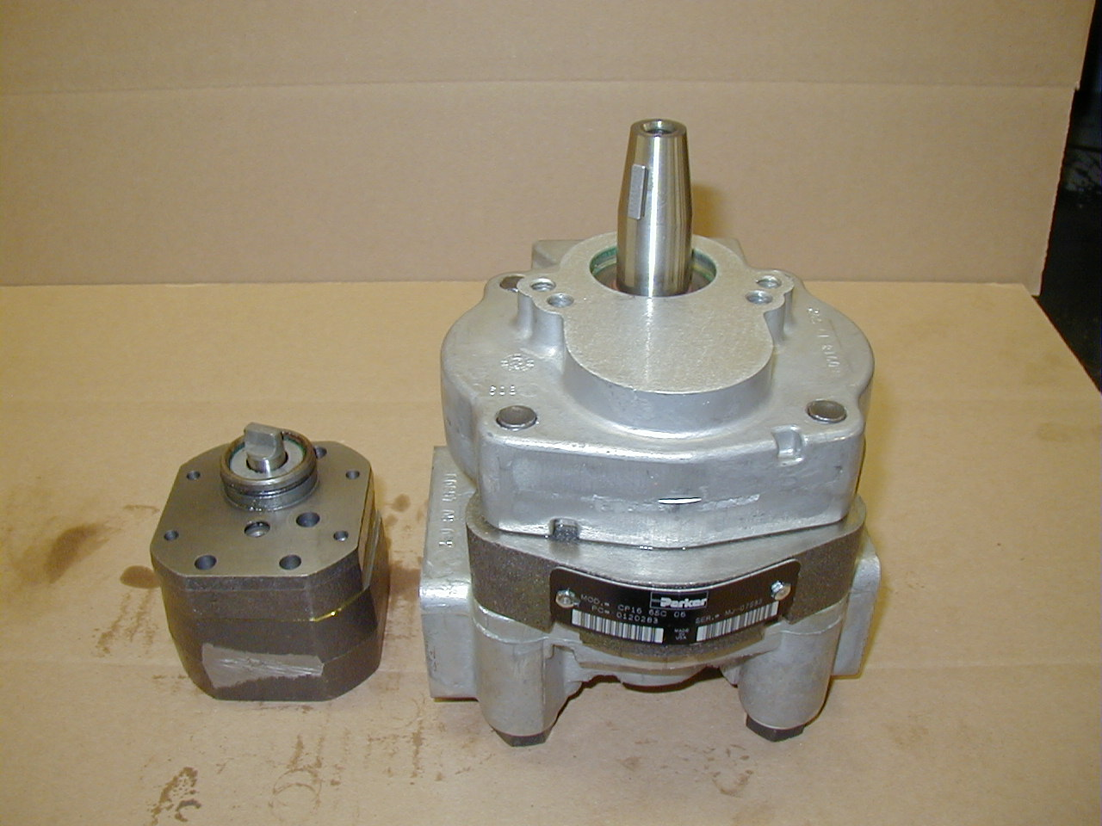
Pump Drive Shaft and Overall Dimensions
Input shaft diameter & overall pump dimensions
Our Choice:
Clutch Pump
7/8” shaft, key & taper drive
1/2” shaft, tang drive

Slide 11
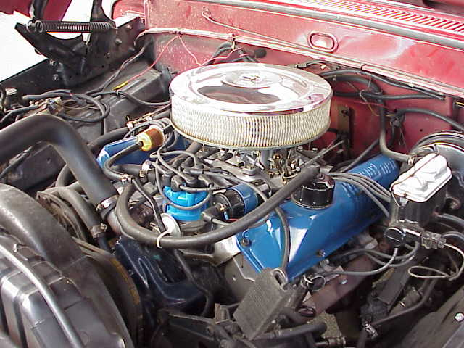
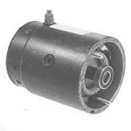
Hydraulic Pump Drive System
Electric starter motor drive
Belt-drive from truck’s engine
Our Choice:
Live Engine Power

Slide 12
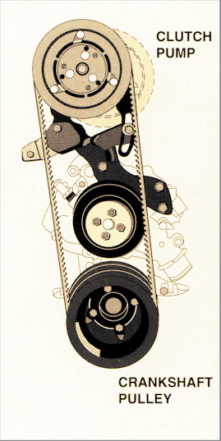
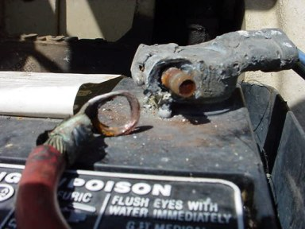
Hydraulic Pump What Power Source?
Battery power, 15 feet of cable & several high-amp connections that are eventually likely to corrode?
Simple, Proven V-Belt Drive
Our Choice:
Belt Drive

Slide 13


12-Volt Hydraulics: Battery Life
In 1980, 12-Volt hydraulic system owners often stated: “My local battery retailer told me he was sorry, but he just couldn’t sell me any more batteries with warranty!”
Our Decision:
Too much hassle!

Slide 14
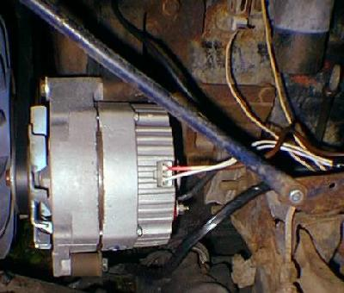
12-Volt Hydraulics: Charging System Challenges
12-volt hydraulic systems create significant additional load on alternator
All power must still be produced by the engine
Our Decision:
Alternators already have enough load!

Slide 15
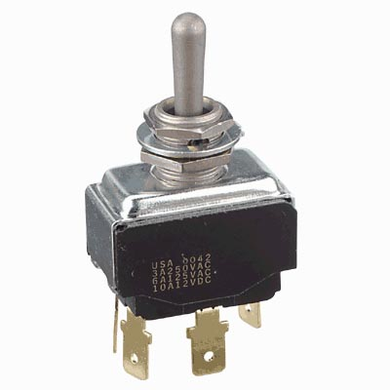
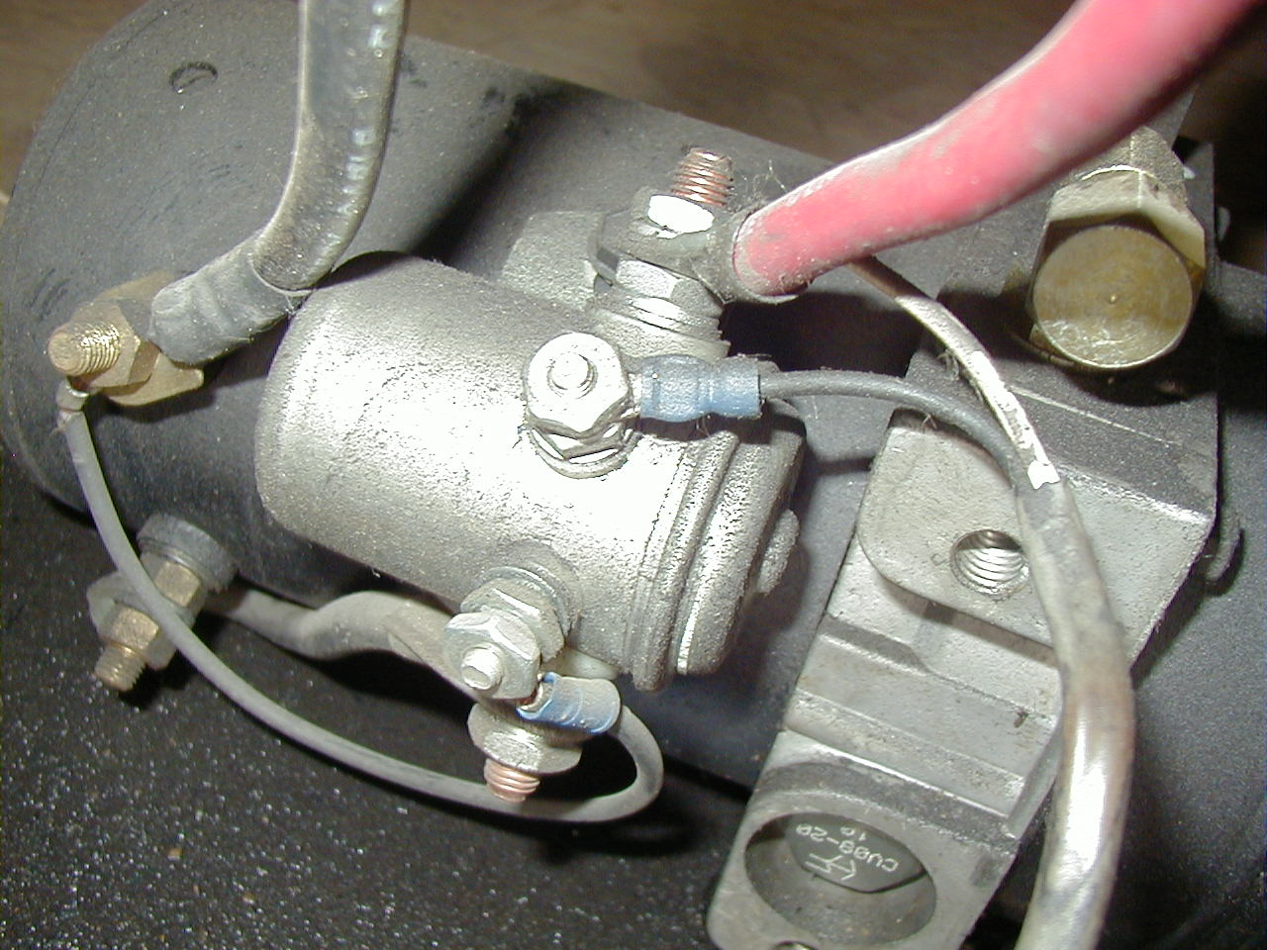
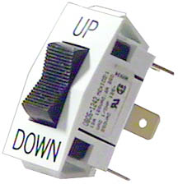
12-Volt Hydraulics: Switches & Solenoids
Each bale handler motion requires the control switches & solenoids to connect and hold an electrical load
Our Decision:
We’ve don’t need the complexity or the vulnerability!

Slide 16
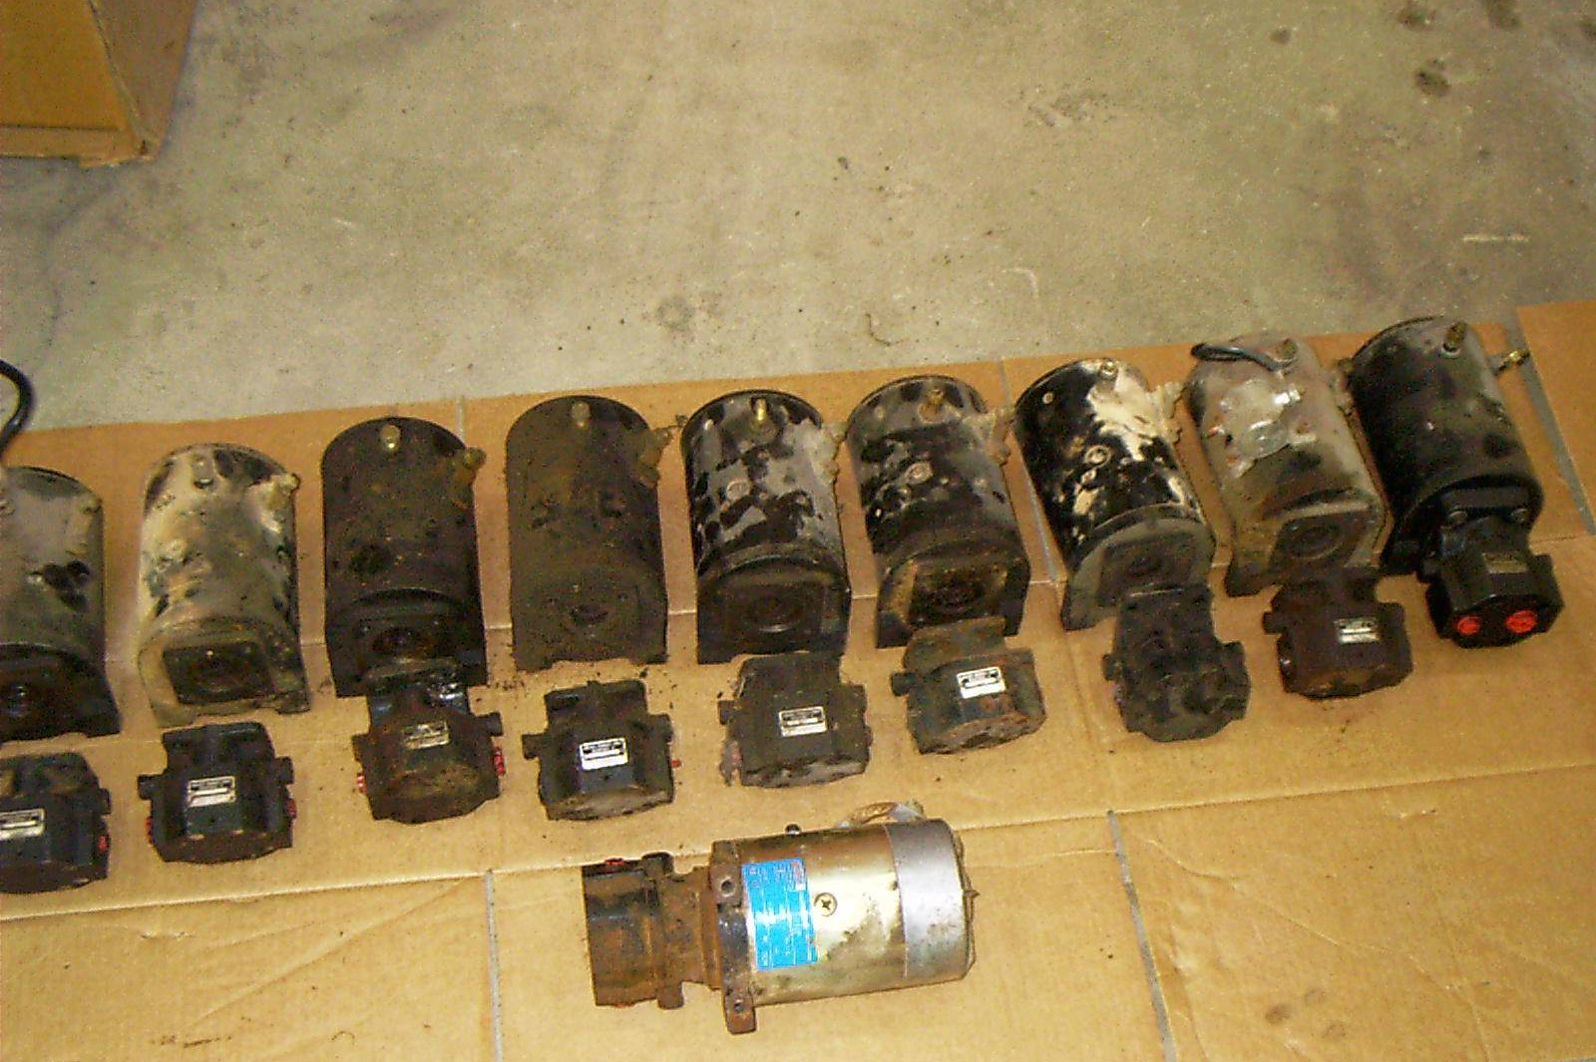
12-Volt Hydraulics: Repair Costs
During a recent winter season, these failed 12-volt motors & pumps were replaced at the bed owner’s expense by the dealer. No photo is available of the large number of additional units that were replaced under manufacturer’s warranty. Photo courtesy: The Arc Shop - Exeter, MO
Replacement 12-Volt control switch: $6.00
Replacement 12-Volt motor solenoid: $12.00
Replacement truck battery: $60.00
Replacement 12-Volt pump drive motor: $250.00
Equipment Down-Time: Costly & Frustrating!
Clutch Pump Dependability: Priceless!
Our Decision:
The dependability of the clutch pump hydraulic system!

Slide 17
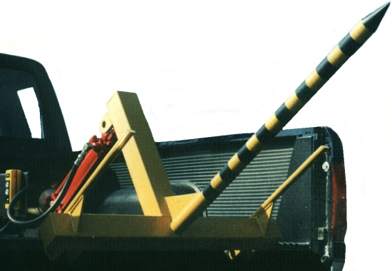
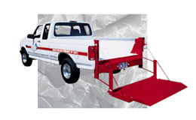
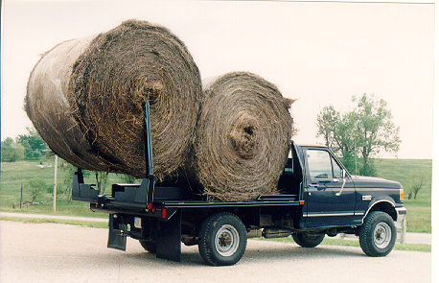
Are 12-Volt hydraulic systems a good choice for some applications?
Lift gates on delivery trucks? Yes, due to single action function, low duty cycle & low oil flow requirements
Bale spikes & spike beds? Yes, due to low duty cycle & oil volume requirements and single circuit function
Bolt-down bale handlers for low volume operations? Yes with special provisions for increased current supply

Slide 18
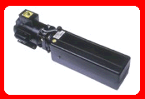
Typical 12-Volt Hydraulic Pump Output Flow Declines as Pressure Increases
GPM
Pump output is reduced by half at 2,500 PSI
PSI 500 1,000 1,500 2,000 2,500

Slide 19
Typical 12-Volt Hydraulic Pump Amp Draw Increases as Pressure Increases
Excessive Current - Starter Life & Output Reduced
Amps
Acceptable Current Draw for Vehicle Starter
Current Draw doubles from 500 to 2,500 PSI
PSI 500 1,000 1,500 2,000 2,500

Slide 20
ALL 12-Volt Hydraulic Pumps: Unfortunately, as hydraulic demand increases, pump performance decreases
GPM
Amp Draw
PSI 500 1,000 1,500 2,000 2,500

Slide 21
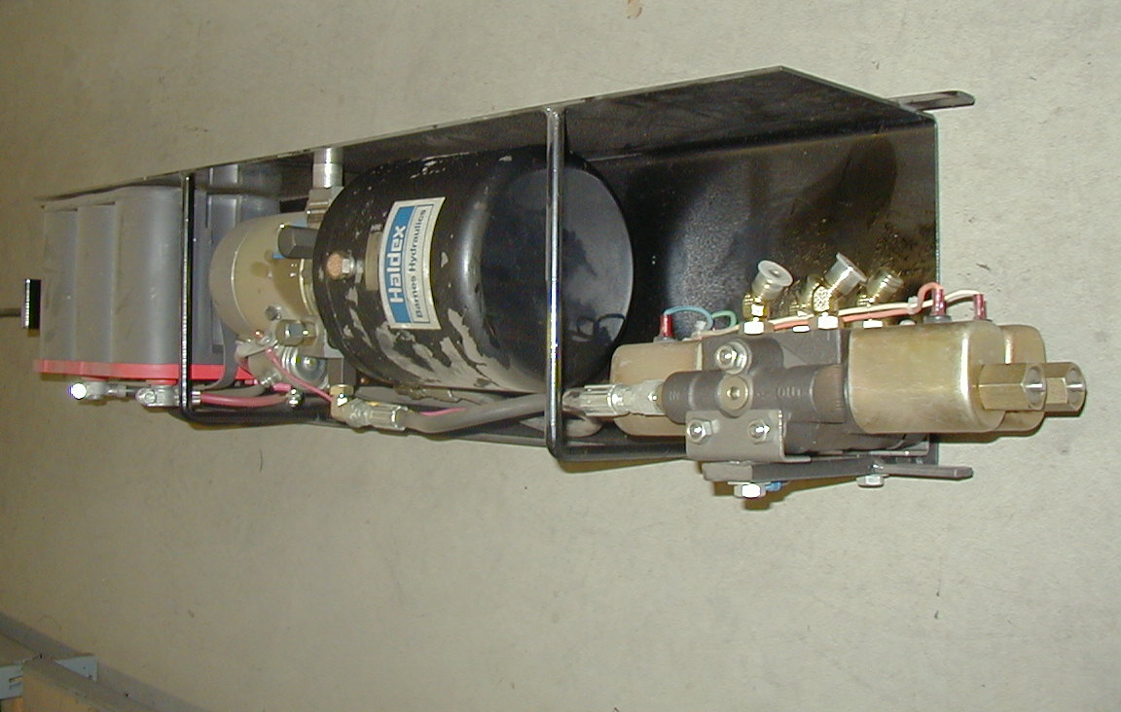
Hydraulic Power Systems: Is Triple C “Up to speed” on 12-Volt Hydraulics?
We build a top-quality 12-Volt hydraulic system for our BD-2200 Bolt Down unit

Slide 22
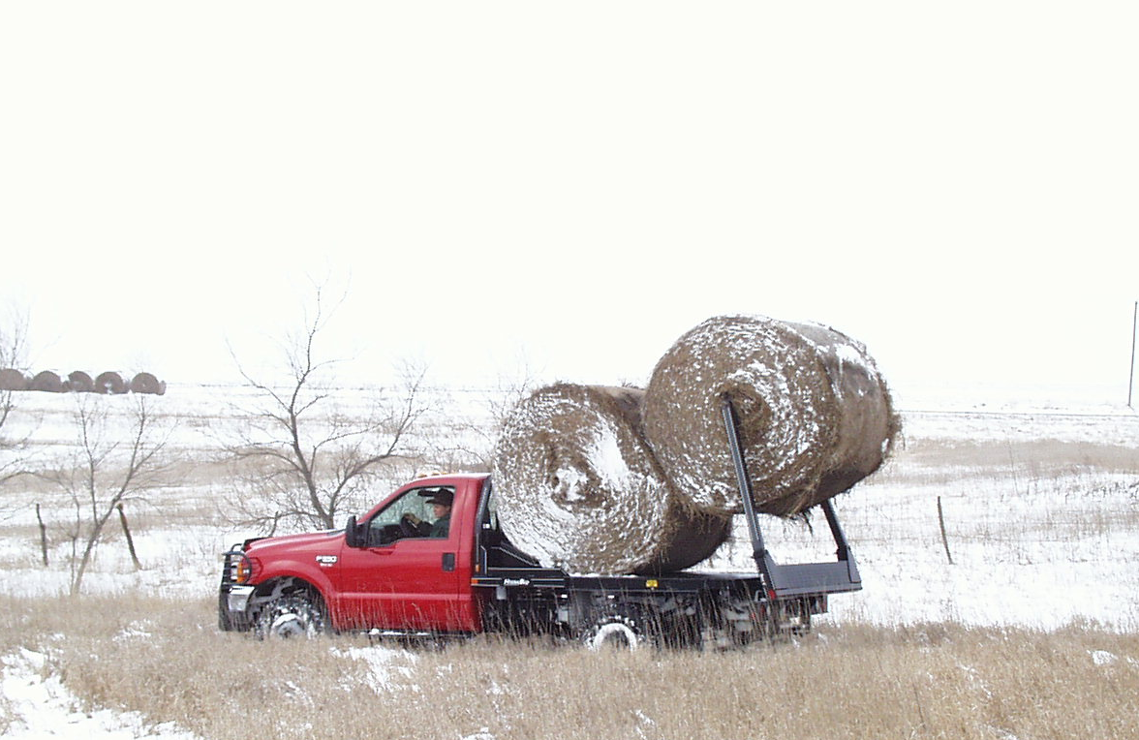
Hydraulic Power Systems: Why don’t we provide Hydra Beds with 12-Volt Hydraulic systems?
Hydra Bed hydraulic systems are expected to provide fast, dependable bale loading during every season of the year.

Slide 23
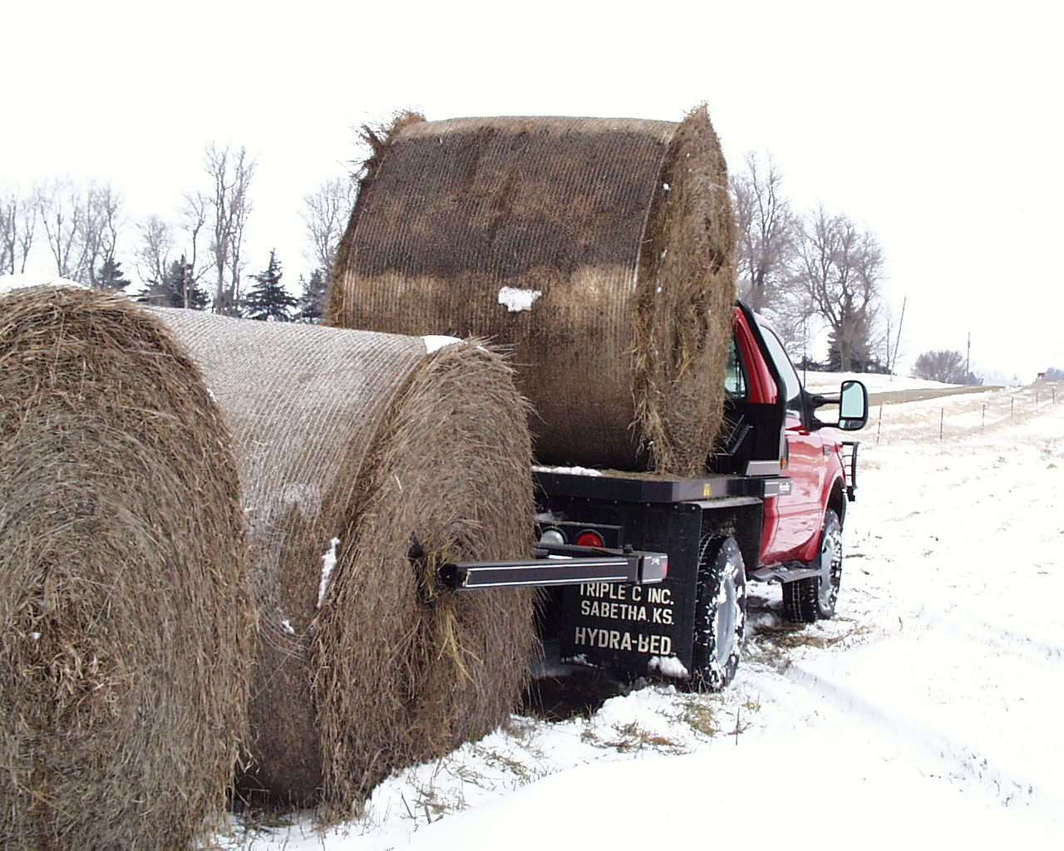
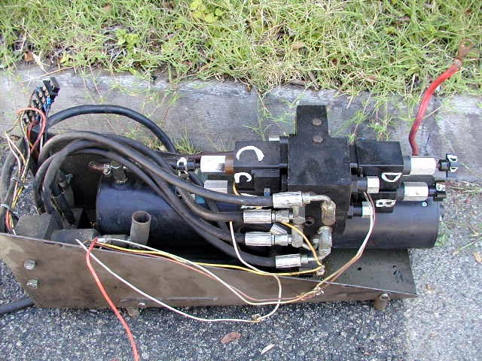
Hydraulic Power Systems Considerations:
In the heat of feeding or haying season, the last thing anyone wants is trouble with hydraulics.
?

Slide 24
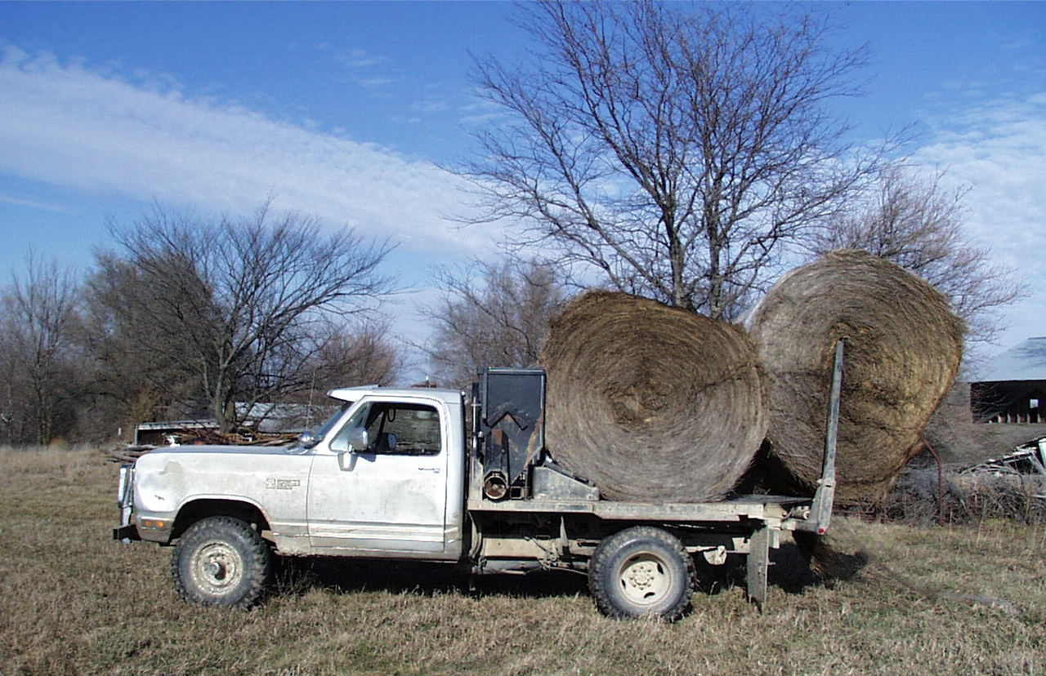
Hydraulic Power Systems: Solution: Clutch Pump & Manual Valve
We believe our customers deserve only the best in Hydra Bed hydraulics!
Our History:
Powerful, Simple, Dependable Hydraulics for 20 years!

Slide 25
Have 12-volt hydraulic systems changed significantly in 23 years?
In 1980, 12-volt hydraulic pump systems were comprised of the following components:
Small displacement, throw-away gear pump
Brush-type, 12-volt starter motor drive
Small capacity (typically less than 1 gallon) oil reservoir

Slide 26
How does that compare to today’s 12-volt hydraulic pumping system?
Today, 12-volt hydraulic pump systems are typically comprised of the following components:
Small displacement, throw-away gear pump
Brush-type, 12-volt starter motor drive
Small capacity (typically less than 1 gallon) oil reservoir
Some now equipped with plastic reservoirs
Some motors now utilize bearings instead of bushings

Slide 27
What about other 12-volt drive motor types?
Permanent magnet motors are now appearing on certain 12-volt hydraulic pumps.
These motors eliminate brush & commutator wear and maintenance, BUT:
They still suffer the basic power limitations of traditional 12-volt hydraulic systems
Duty cycle is still very limited, especially at high output pressures
Flows still decline as pressures increase

Slide 28
What factors limit 12-volt hydraulic pumping system improvements?
Typical 12-Volt pumping system requires 250 amps (4.0 Horsepower) of electrical power to produce 2,500 PSI
At that 2,500 PSI pressure, the system can only deliver 1.3 GPM
At a 250 amp load, the pump can only be run 27 seconds, then, to avoid damage to the motor, MUST be allowed to cool for at least 4-1/2 minutes before being run again
ALL 12-volt hydraulic pumping systems possess similar duty cycle limitations

Slide 29
How does Hydra Bed clutch pump performance compare to 12-volt systems?
The Hydra Bed clutch pump generates 11 GPM @ 2,000 RPM @ 2,500 PSI
At that 2,500 PSI pressure & 11 GPM flow, the pump is utilizing approximately 17 horsepower from the truck engine
The Hydra Bed clutch pump is generating more than 5 times the hydraulic power and has no limits on duty cycle

Slide 30
What does this all mean to the owner of a 12-volt powered bale bed?
12-volt pumping systems on bale beds are routinely abused by duty cycle requirements BEYOND their recommended capacity
While these pumping units will typically not fail immediately from this abuse, their life span is shortened by EVERY such occurrence
It is not uncommon for heavy users of 12-volt bale beds to replace motors and/or pumps as frequently as once a year, often at their own expense
Unfortunately, replacing these expensive components is only a temporary solution to the problem

Slide 31
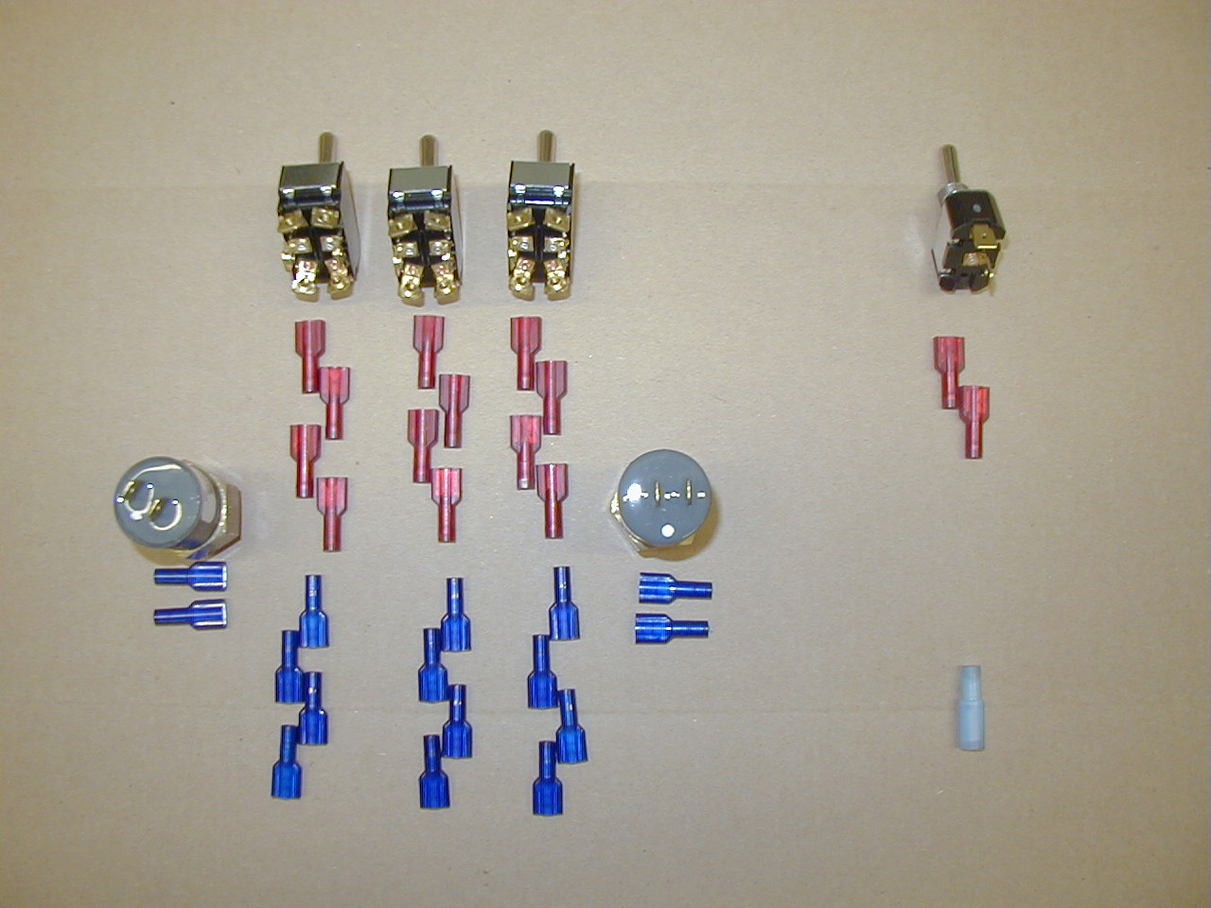
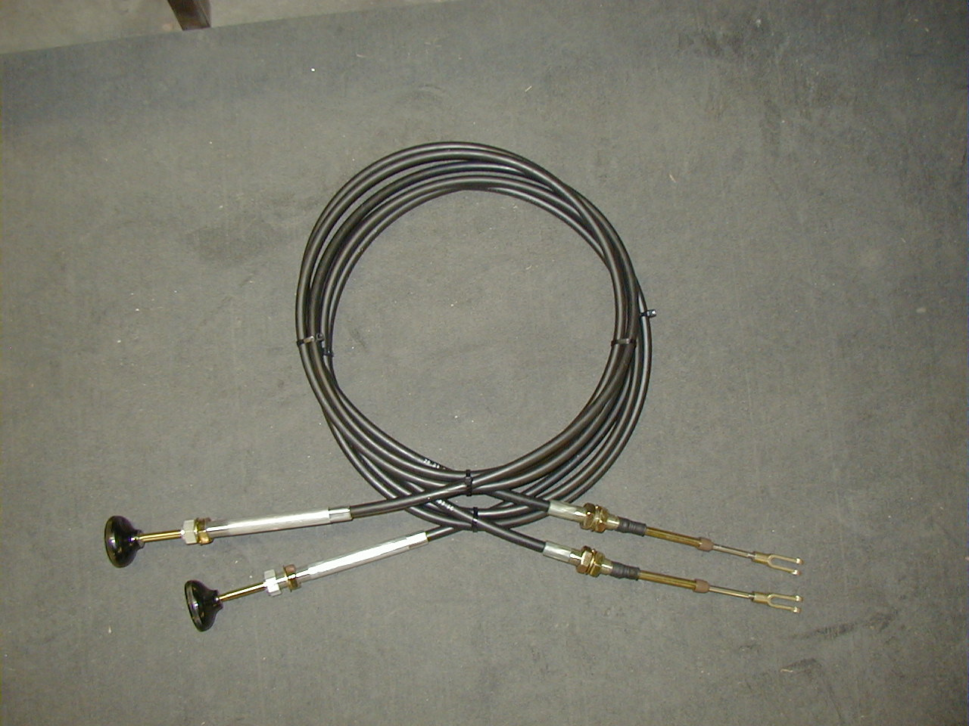
Bale Bed Hydraulics: Control System Complexity
As the quantity & fragility of control components increase, so does the potential for problems.
Our Goal:
Simplicity & dependability!
The Hydra Bed uses 1 toggle switch to engage the clutch pump & 2 sealed cables to operate the valve.
12-volt bale beds use as many as 3 function switches in addition to 1 or 2 micro switches.

Slide 32
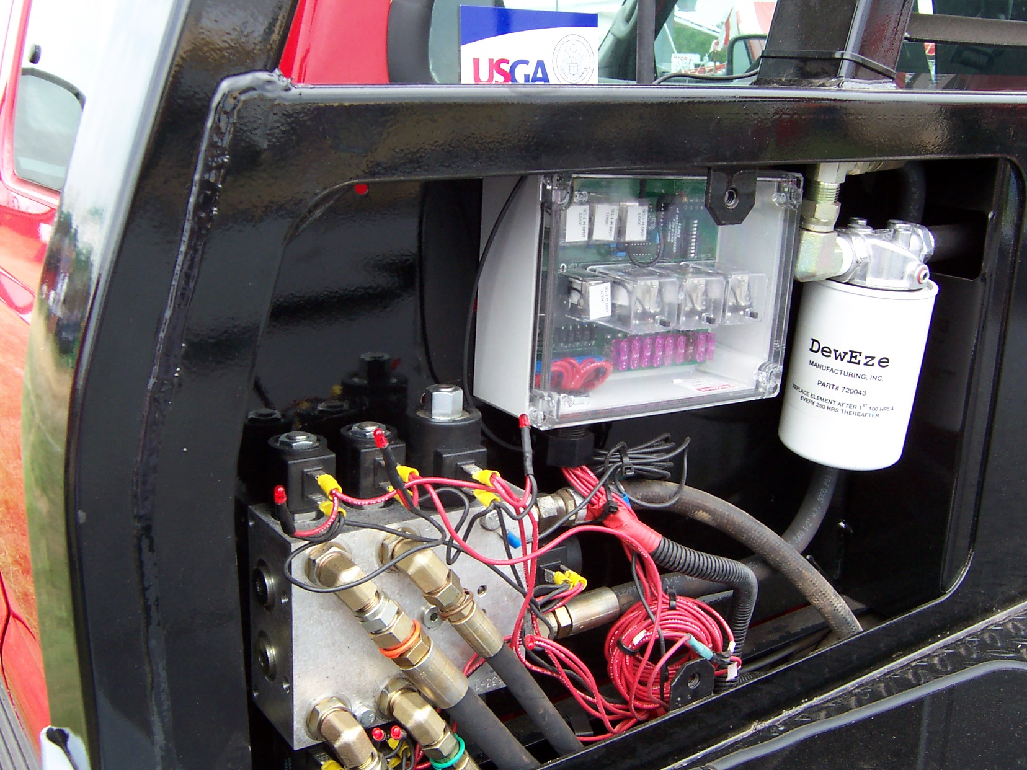
Bale Bed Hydraulics: Troubleshooting Issues
It’s a cold, snowy day in December. Your good customer’s bale bed isn’t working, and he’s got 300 cows that haven’t been fed yet. Where do you start troubleshooting this complex control system?

Slide 33
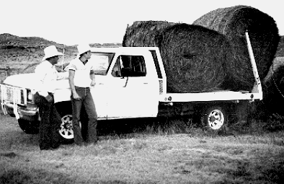
The “Pliers & Baling Wire” approach to ranch equipment maintenance!
Many Hydra Bed owners are too busy caring for their stock to have time to work on equipment!

Slide 34

The “I can do anything that can be done from a saddle!” approach
These good operators are usually much better stockmen than they are mechanics!

Slide 35

The “Not Mechanical!” approach
Some are just not comfortable doing mechanical work. These customers will often tell you that they are often better off NOT working on their equipment!

Slide 36
The approach
Few (if any) sensitive and/or fragile components used in equipment design & construction
Products developed & intended to excel under the normal abuse of ranch life
Simple diagnostic & repair procedures
Easy access to all key components

Slide 37
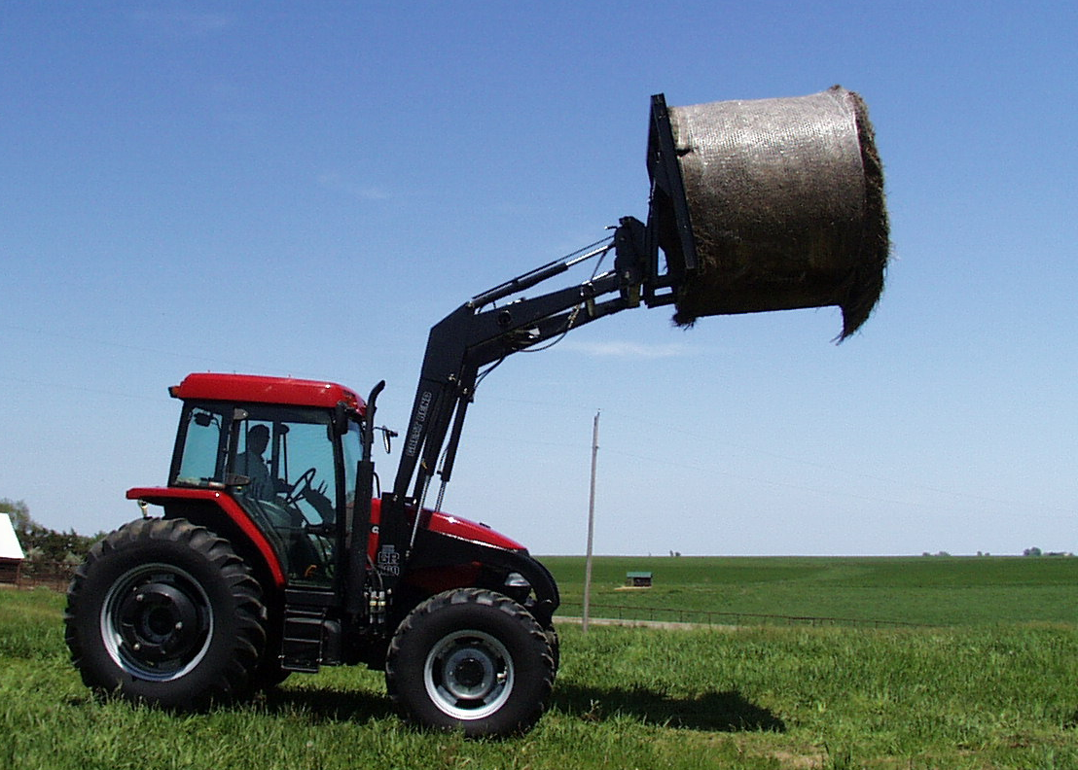
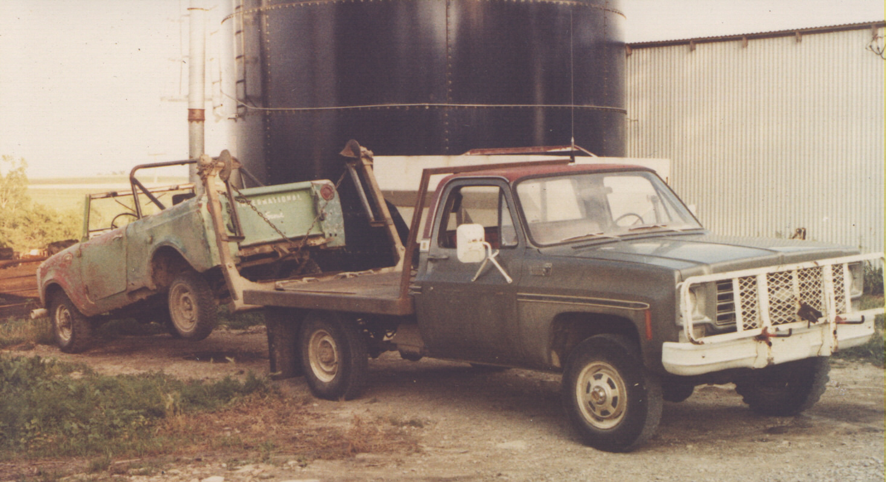
Bale Bed Hydraulics: Valve “Feathering” Capability
Like a tractor front loader, a bale bed is used for many unique lifting & loading tasks
Our Choice:
Fully-variable manual controls!
In a tractor loader system, good valve metering is critical. On-Off solenoid valves just aren’t capable of providing the variable flow control necessary for smooth, safe operation of load handling equipment.

Slide 38
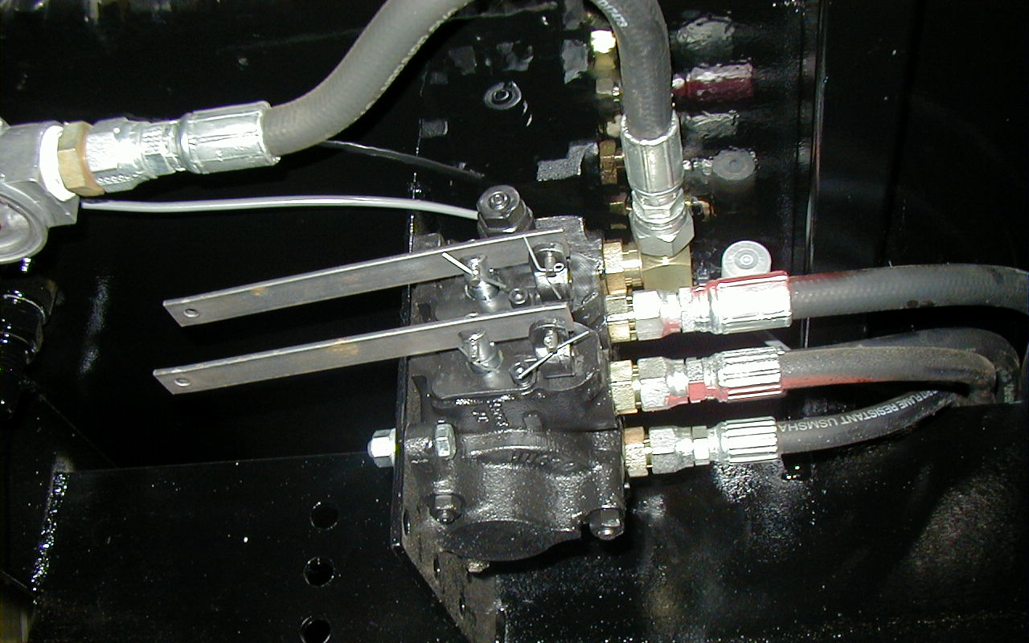
Bale Bed Hydraulics: Valve Load Checks
Load Checks are integral to the design of Hydra Bed manual control valves, and have been for 20 years
This key feature prevents unwanted load movement during spool shifting
Our Choice:
Load check-equipped manual valves for 20 years!

Slide 39
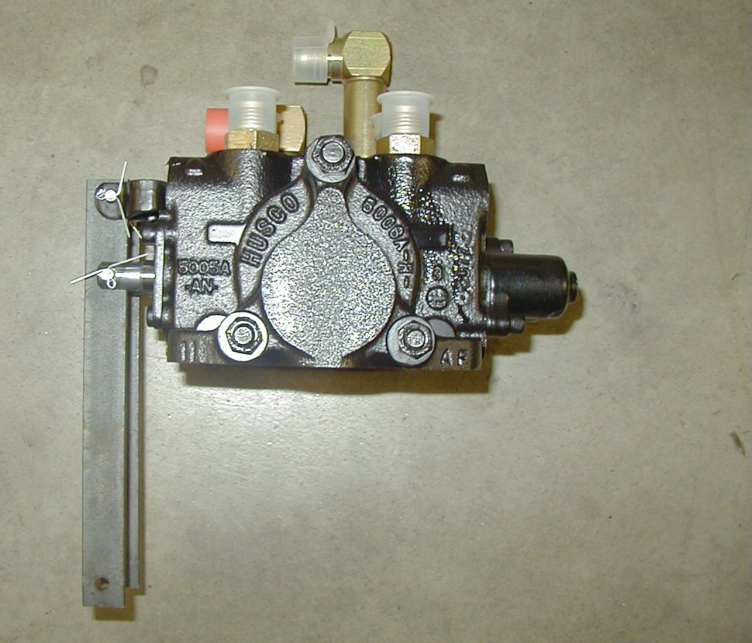
Hydraulics: Control Valve Summary
Simplicity
Ruggedness
Dependability
Excellent metering
Superior control of fast-moving, heavy loads
Our Choice:
Trouble-Free manual valves for 20 years!

Slide 40
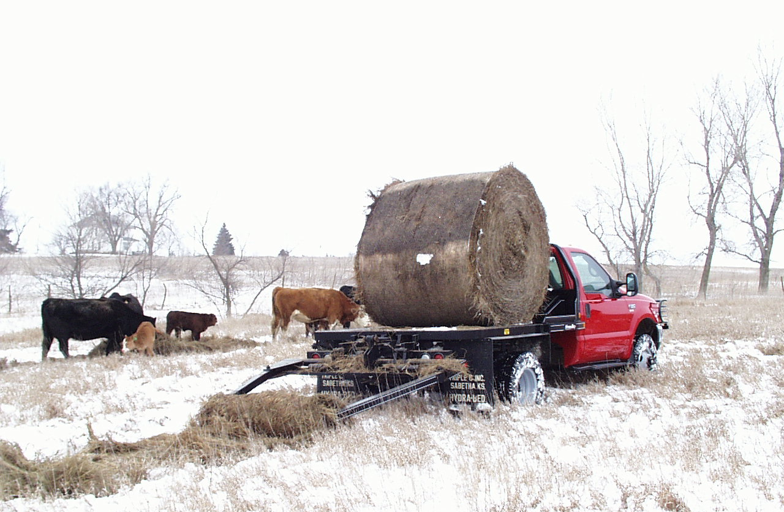
Hydraulic Systems Dependable Clutch Pump & Manual Valve!
Our Committment:
Powerful, Simple, Dependable Hydraulics for over 20 years!

Slide 41
Bale Bed Hydraulic Systems: Calculating Cylinder Force
The result will be expressed in pounds. For systems with dual cylinders, multiply by 2. Dividing by 2,000 gives force in Tons.
The mathematic formula for calculating Hydraulic Cylinder Force is very simple:
Inside Area - Shaft Area x System Pressure
-
x
Pounds/Square Inch

Slide 42
Lift Cylinder Effective Area
System Pressure 2,500 PSI
Total Effective Lifting Area 14.1 Square Inches
Total Force Generated 17.6 Tons
Inside Diameter 4-1/2”
Shaft Diameter 1-1/2”

Slide 43
Lift Cylinder Effective Area
DewEze®
System Pressure 2,200 PSI
Total Effective Lifting Area 14.1 Square Inches
Total Force Generated 15.9 Tons
Inside Diameter 4-1/2”
Shaft Diameter 1-1/2”

Slide 44
Lift Cylinder Effective Area
Steerman™
System Pressure 2,250 PSI
Total Effective Lifting Area 10.8 Square Inches
Total Force Generated 12.2 Tons
Inside Diameter 4”
Shaft Diameter 1-1/2”

Slide 45
Lift Cylinder Effective Area
Krogmann™
System Pressure 2,500 PSI
Total Effective Lifting Area 10.8 Square Inches
Total Force Generated 13.5 Tons
Inside Diameter 4”
Shaft Diameter 1-1/2”

Slide 46
Lift Cylinder Effective Area
Hoswel™
Total Effective Lifting Area per Cylinder 5.8 Square Inches Times 2 Cylinders = 11.6
System Pressure 2,000 PSI
Total Force Generated 11.6 Tons
Inside Diameter 3”
Shaft Diameter 1-1/4”
Dual Lift Cylinders

Slide 47
Lift Cylinder Effective Area
Besler™
Total Effective Lifting Area per Cylinder 5.8 Square Inches Times 2 Cylinders = 11.6
System Pressure 2,500 PSI
Total Force Generated 14.5 Tons
Inside Diameter 3”
Shaft Diameter 1-1/4”
Dual Lift Cylinders

Slide 48
Lift Cylinder Effective Area
Cannonball™
Total Effective Lifting Area per Cylinder 5.8 Square Inches Times 2 Cylinders = 11.6
System Pressure 2,250 PSI
Total Force Generated 13.1 Tons
Inside Diameter 3”
Shaft Diameter 1-1/4”
Dual Lift Cylinders

Slide 49
Important Background Information
Lift cylinder force calculations were made using industry-standard hydraulic formulas
All cylinder dimensions and system relief pressure values are from product advertising or were provided by representatives of the various companies
Cylinder force values are compared in the next table
The final table compares estimated lift capacities based on the calculated cylinder force values
Every effort has been made to provide accurate, unbiased information in these comparisons
We reserve the right to make additions or corrections as additional information becomes available

Slide 50
Bale Bed Hydraulic Systems: Comparing Cylinder Force
17.6 Tons - The Leader
DewEze 15.9 Tons 90% of Hydra Bed
Besler 14.5 Tons 82% of Hydra Bed
Krogmann 13.5 Tons 77% of Hydra Bed
Cannonball 13.1 Tons 74% of Hydra Bed
Steerman 12.2 Tons 69% of Hydra Bed
Hoswel 11.6 Tons 66% of Hydra Bed

Slide 51
Simple Bale Bed Facts:
Fact: Cylinder force (area times pressure) is a key factor in comparing true bale bed lift capacity
Fact: All listed bale beds use similar lift cylinder strokes, ranging from DewEze at 16” to all others at 20”
Fact: All listed bale beds convert that cylinder stroke to a similar bale arm swing radius
Fact: The lift cylinder in a Hydra Bed will produce 17.6 Tons of force at the factory system relief pressure of 2,500 PSI
Fact: That 17.6 Tons of force will lift 3,000# at the spinner bushing of a Series 150 Hydra Bed
Fact: Advertised lift capacities should reflect true lift capacities

Slide 52
Advertised Lift Capacity compared to Calculated Lift Capacity
3,000# 3,000# 0# 0%
Lift Capacity Calculated from Cylinder Force
Advertised Lift Capacity
Estimated Discrepancy
DewEze 2,750# 2,700# -50# -2%
Besler 2,200# 2,460# +260# +11%
Krogmann 2,750# 2,310# -440# -19%
Cannonball 2,850# 2,220# -630# -28%
Steerman 2,850# 2,270# -580# -26%
Hoswel 2,500# 1,980# -520# -26%

